Slide 1

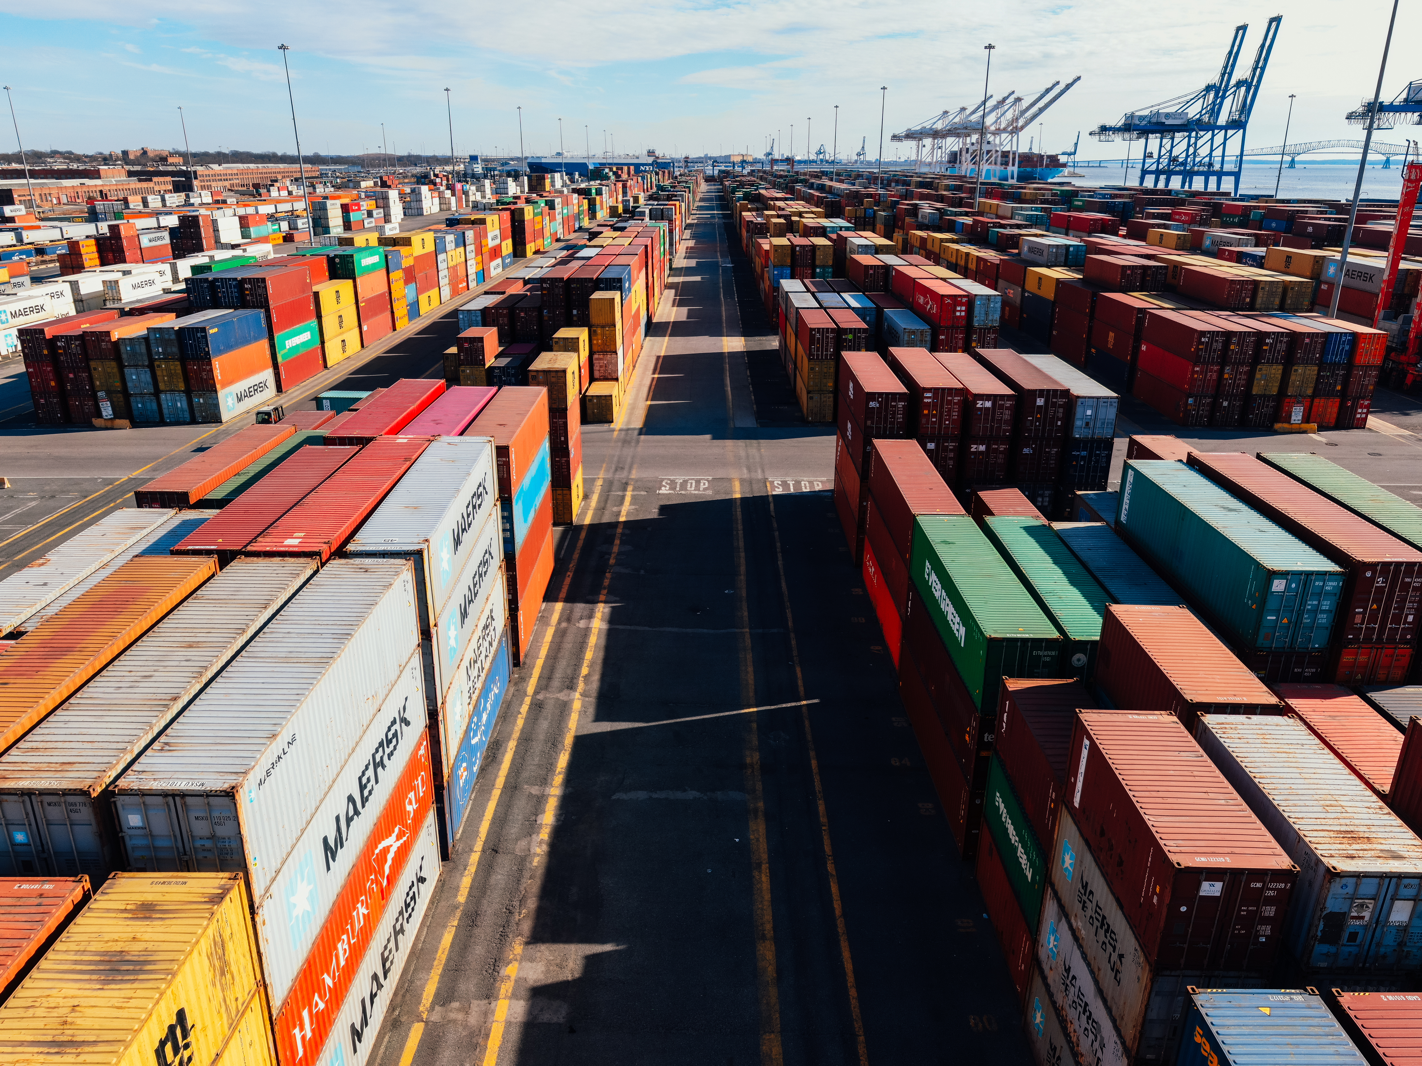
Supply Chain Management
-

Slide 2

Supply Chain Management
Supply Chain Management (SCM) is the coordination and management of all activities involved in sourcing, procurement, conversion, and logistics. It includes the flow of materials, information, and finances as a product moves from supplier to manufacturer to wholesaler to retailer to consumer.
Goal of SCM: To maximize customer value and achieve a sustainable competitive advantage.

Slide 3

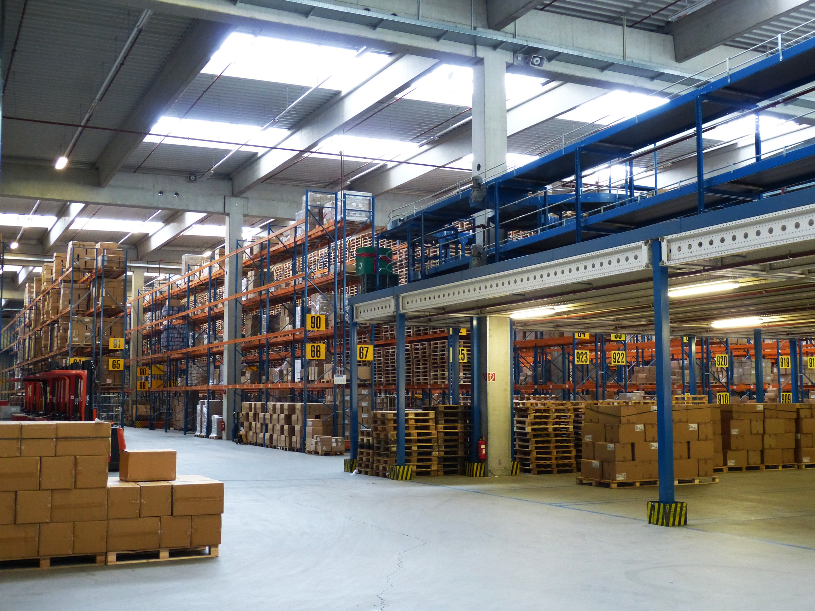
Main Divisions in SCM
Procurement or Sourcing
Inventory Management
Warehouse and Storage
Transportation or Logistics
Production or Manufacturing
Demand Planning and Forecasting
Order Fulfillment
Customer Relationship Management(CRM)
Returns Management
Supply Chain Planning and Coordination

Slide 4
Key Technologies in SCM
Enterprise Resource Planning(ERP)
Internet of Things(IoT)
Artificial Intelligence and Machine Learning
Block Chain
RFID and Barcoding
Cloud Computing
Robotics and Automation
Advanced Analytics and Big Data
3D Printing

Slide 5
ERP in SCM
ERP is a type of software system that integrates and manages core business processes in real-time through a centralized database.
In Supply Chain Management, ERP helps with:
Inventory Management
Procurement and Sourcing
Production Planning
Order Processing
Financial Tracking
Logistics and Transportation Coordination
Example:
SAP
Oracle Netsuite
Microsoft Dynamics 365

Slide 6
CRM in SCM
CRM is software designed to manage a company’s interactions with current and potential customers.
In Supply Chain Management, CRM helps with:
Understanding customer demand and behavior
Capturing customer feedback for quality control
Managing orders, service, and complaints
Enabling customized supply chain responses
Examples:
Salesforce
Zoho CRM
Hubspot

Slide 7
Importance of Supply Chain Management in Modern Business
Operational Efficiency
Cost Reduction
Customer Satisfaction
Competitive Advantage
Risk Management
Sustainability
Globalization Support

Slide 8
Real-World Examples
Amazon
Technology-Driven Logistics: Uses robotics, AI, and big data to optimize warehouse operations and delivery routes.
Prime Delivery: SCM enables 1–2 day delivery across global markets.
Fulfillment Centers: Strategic locations reduce shipping times and costs.
Apple
Integrated Global Supply Chain: Manages components sourced globally and assembles them with precise timing.
Vendor Relationships: Strong ties with suppliers ensure quality and availability
Inventory Mastery: Keeps low inventory levels while avoiding stockouts through accurate forecasting

Slide 9
Project Objective
Enhance Supplier Performance Monitoring
Track on-time delivery rates, lead times, and defect rates.
Identify high-risk suppliers and optimize sourcing strategies.
Reduce Supply Chain Costs
Analyze logistics, warehousing, procurement, and transportation data.
Identify inefficiencies and opportunities for cost savings.

Slide 10
Tools and Methodology
Excel: Initial data cleaning and transformation
SQL: Data extraction ,views and queries as a data source for BI tools.
Power BI & Tableau: Visualization and dashboarding
KPI Framework: Standardized retention metrics

Slide 11
Key KPI’s Measured
Product Wise Sales
Sales Growth
Daily Sales Trend
State Wise Sales
Top 5 Store Wise Sales
Region Wise Sales
Total Inventory
Inventory Value
Overstock, Out-of-stock, Under-stock
Purchase Method Wise Sales

Slide 12
Description of each KPI’s
This suggests strong profitability, with a significant margin between revenue and cost. Where Total cost was $116.93M and revenue generated was $373.81M
YTD sales - Displays annual sales totals which was at peak in 2022 with $92.57M and there was a drop in 2023 which plummets to $24.13M
Sales Growth Percentage – In 2019–2022: Positive but slowing growth (14.92% → 1.57%) and in 2023 Massive decline of 73.93%
Monthly Sales Trend - Shows a monthly breakdown for a single year for e.g.- In 2023 the Highest month was march where the sales was of $37.75M and the lowest was December where the sales was $26.26M.
Product Wise Sales – Here the top performer was Arts and Entertainments with the sales of $88.37M.
Top 5 Store Wise Sales - Argyle Store & Clarges Store contributed the highest sales of 23% each.
State Wise Sales - California dominates, followed by Texas, North Carolina, Massachusetts, etc. Maine & Idaho states have negligible sales.

Slide 13
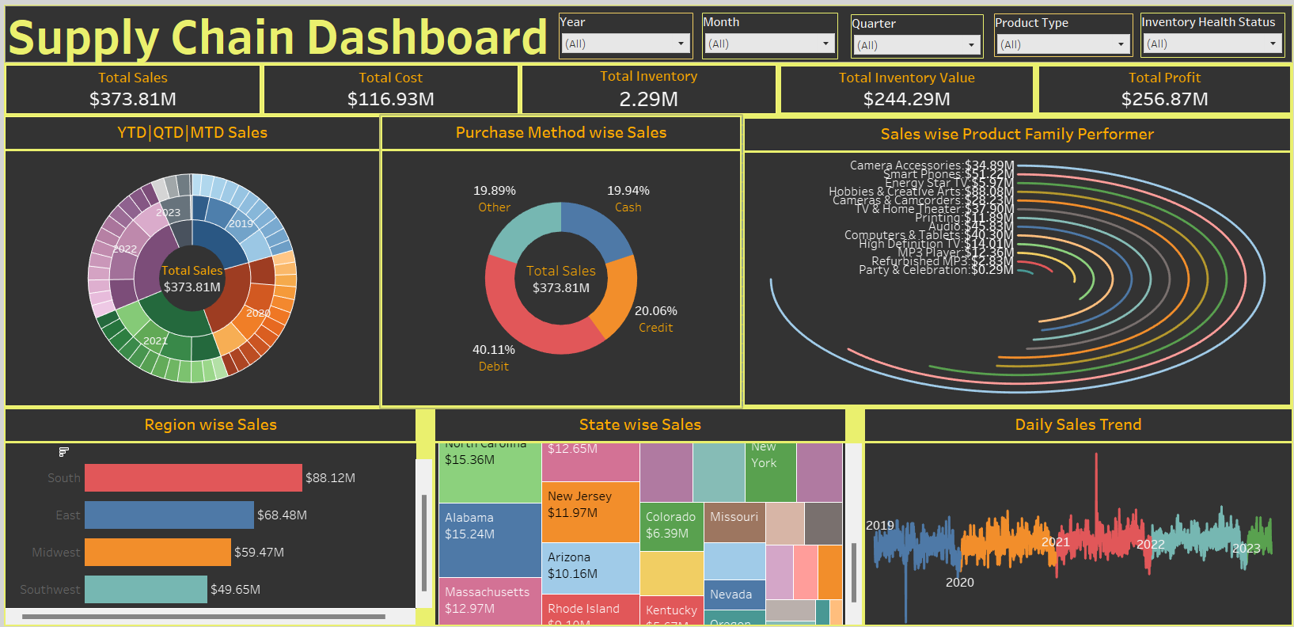
Tableau Dashboard

Slide 14

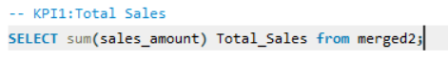
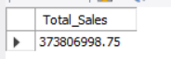
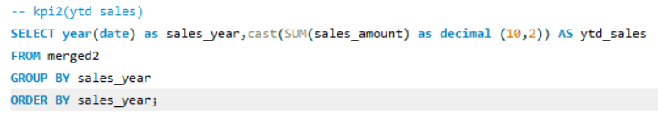
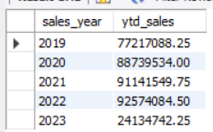
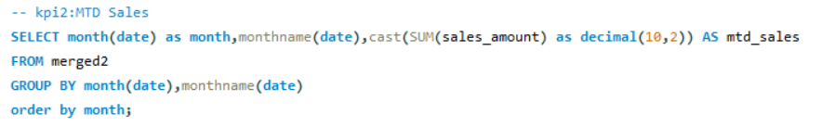
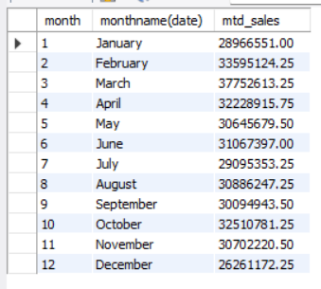
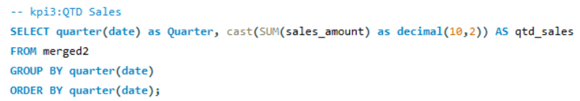
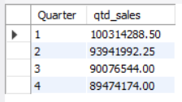
SQL Queries

Slide 15
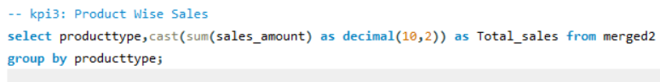
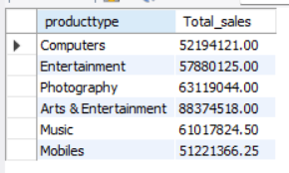
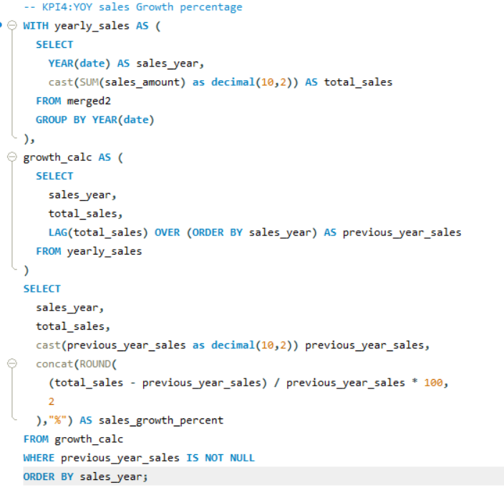
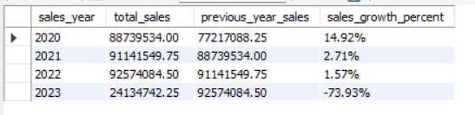

Slide 16
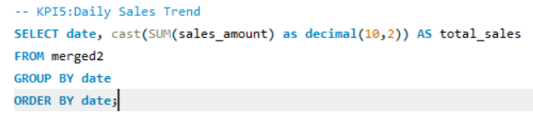
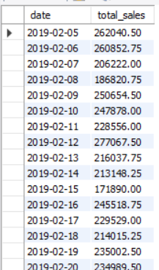
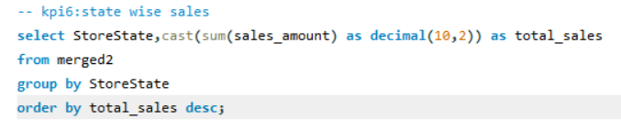
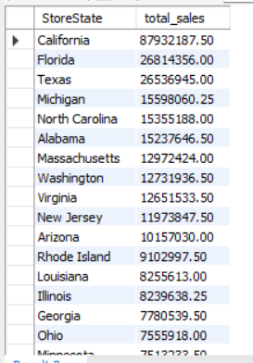

Slide 17
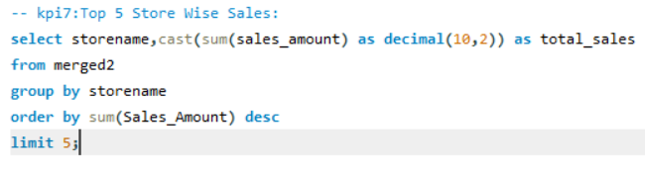
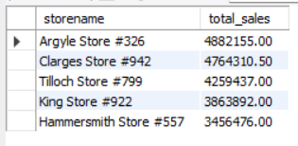
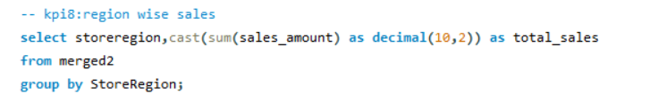
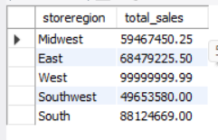
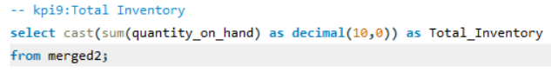
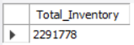

Slide 18
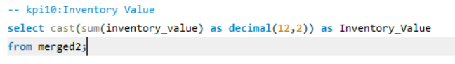
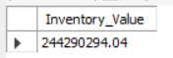
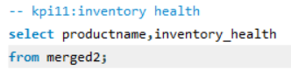
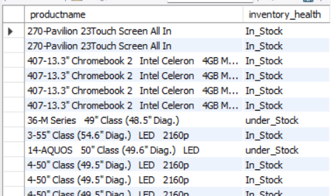
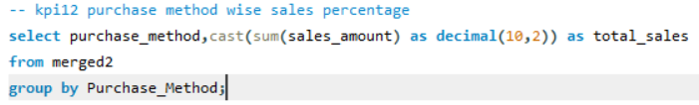
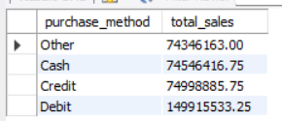

Slide 19
Key Takeaways
Data analytics is a game-changer for supply chain management, enabling companies to move from intuition-based decisions to insight-driven strategies. By harnessing historical, real-time, and predictive data, businesses can optimize inventory, forecast demand more accurately, improve supplier performance, reduce operational risks, and enhance customer service.
Ultimately, data analytics makes supply chains smarter, more agile, and more resilient, helping organizations stay competitive in a rapidly changing market environment

Slide 20
Recommendations
Implement End-to-End Visibility
Optimize Inventory Management
Enhance Demand Forecasting
Supplier Performance Analytics
Route Optimization
Customer-Centric Analytics
Sustainable Supply Chain Analytics

Slide 21
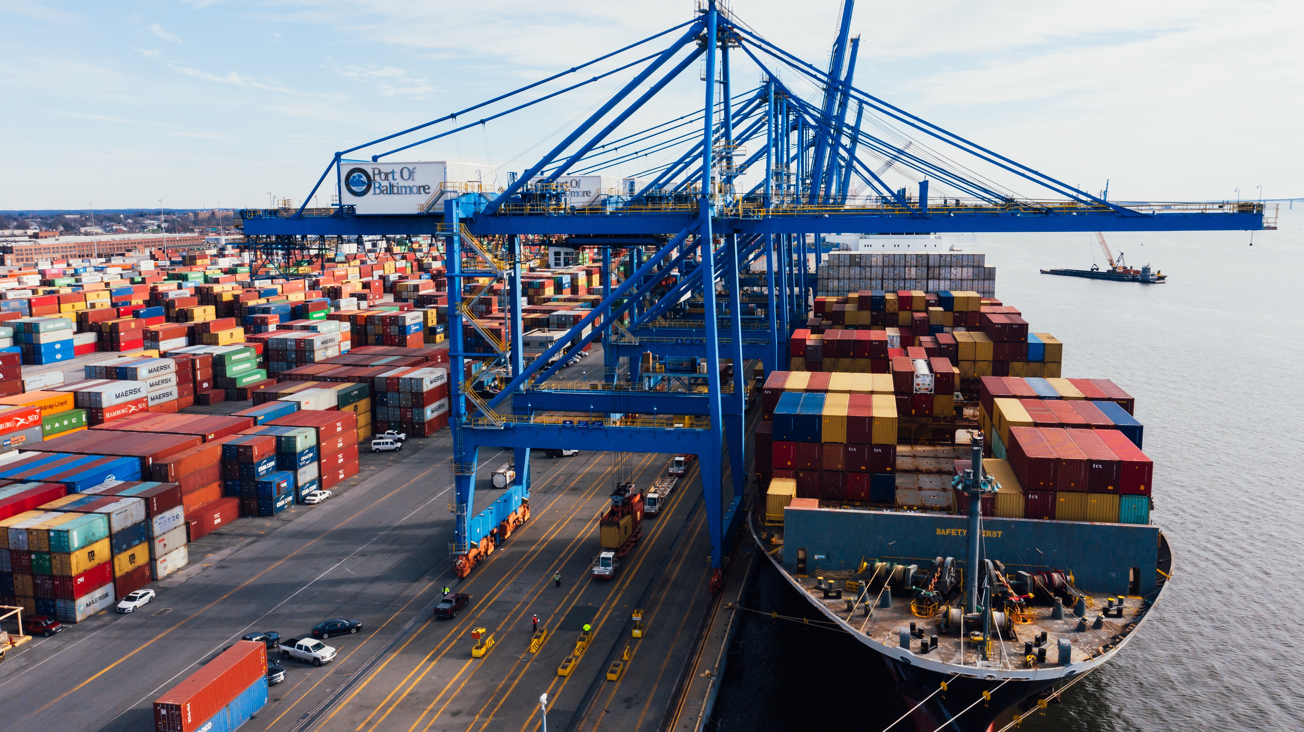
Thank You
-

